Slide 1
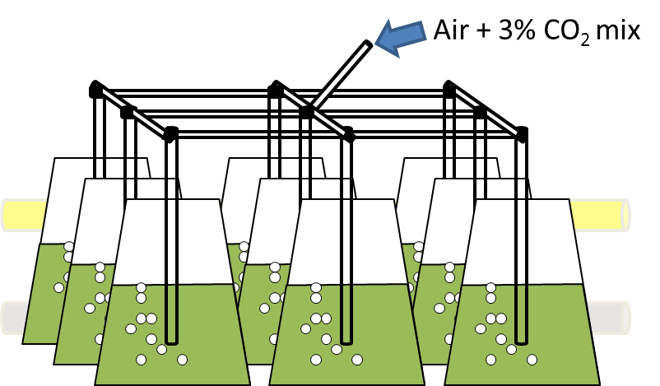
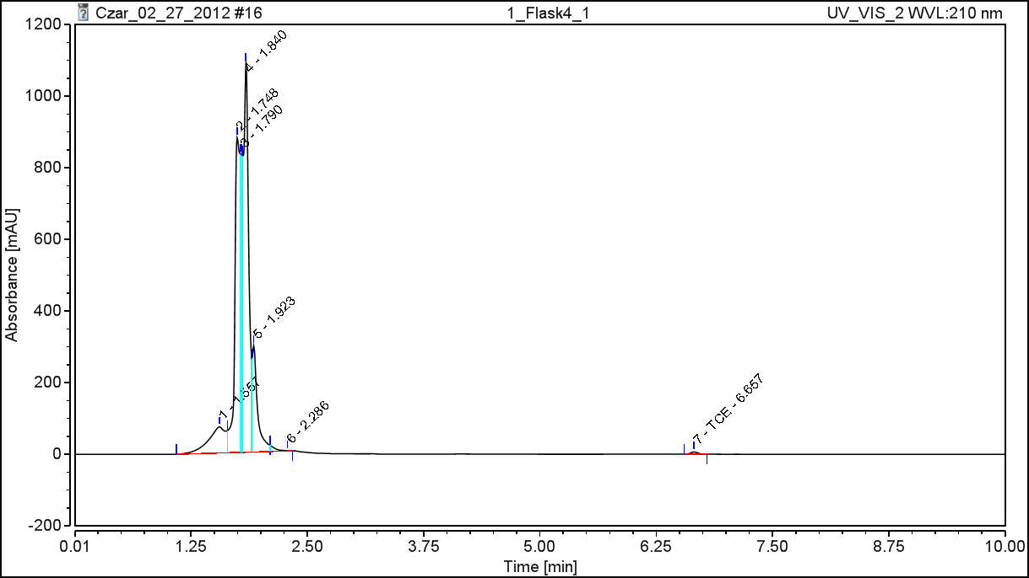
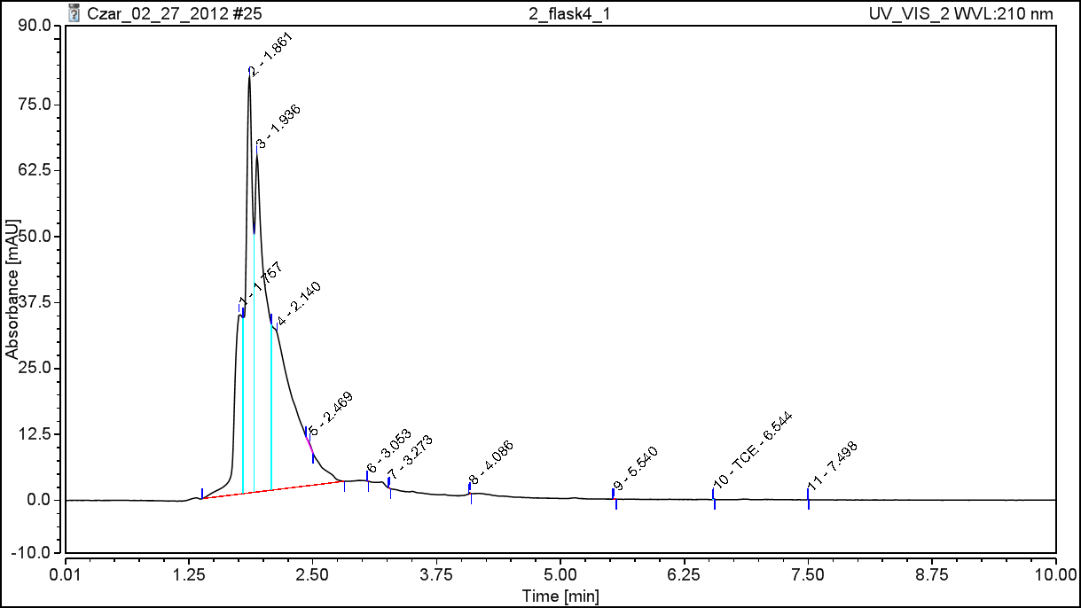
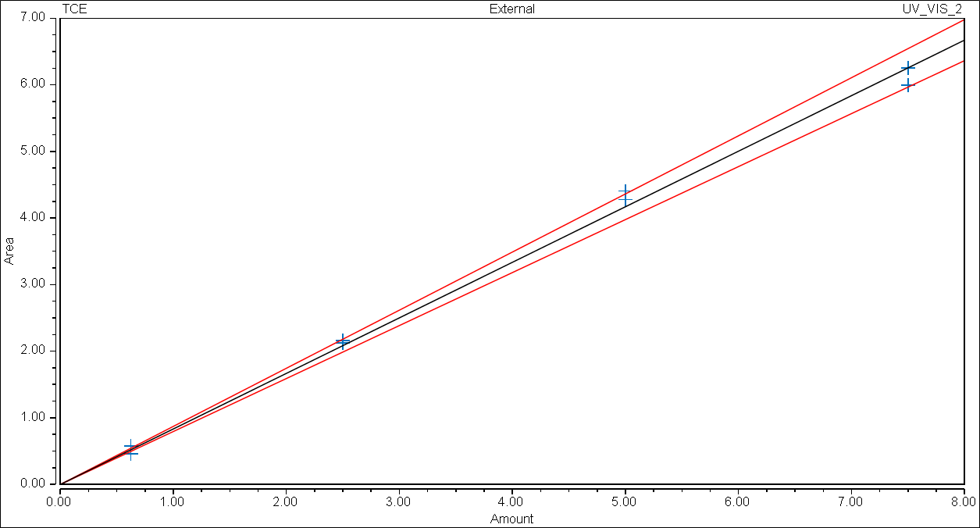
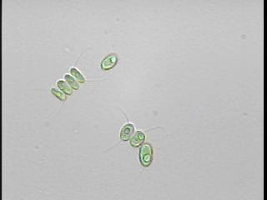
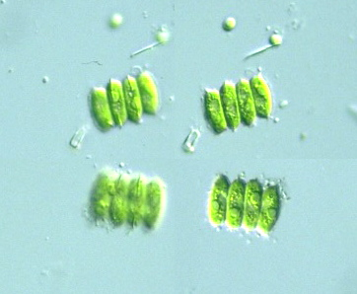
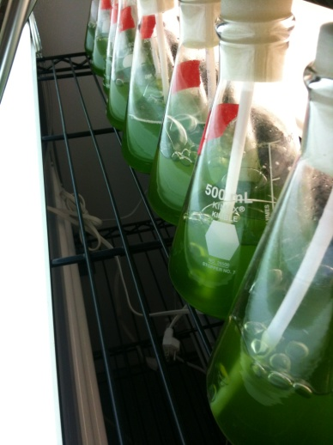
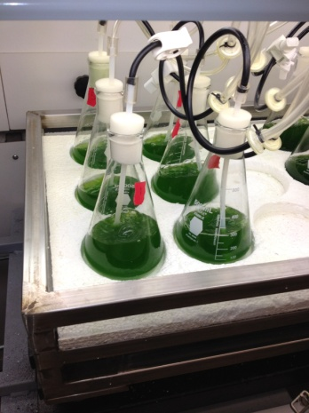
Utilization of algae for TCE Remediation Z. Vance, C. Crofcheck, M.Montross, A. Shea, Biosystems and Agricultural Engineering, University of Kentucky R. Andrews, M. Crocker, Center for Applied Energy Research, University of Kentucky
Introduction
The Gaseous Diffusion plant in Paducah, Kentucky has been in operation for over 60 years and is a vital source for our nation’s nuclear power industry. However, it has two very harmful side effects: Technetium-99 and trichloroethylene. These contaminants seep into the groundwater and are very harmful to living organisms. While remediation methods exist, they are costly and a more cost effective treatment is sought. Based on previous research, it appears algae can be used to remove these contaminants.
Manganese was chosen as a surrogate based on its physical characteristics. Experimental data shows that algae grows in the technetium with little or no effect on the algae growth rate.
A parallel trial indicates that algae also grow in the presence of trichloroethylene but growth is slightly inhibited.
Results
Methods
Manganese was chosen to be used as a surrogate for Tc-99 based on similar chemical properties. Due to unknown limitations on the testing equipment, 1000ppm was chosen as a starting concentration.
TCE was made in 25ppm concentration.
Manganese
Each algae culture was started with 400ml of media
Target algae inoculum concentration of 0.1 g_{dw}/L
Adjustment to 1000ppm manganese
Trichloroethylene
Each algae culture was started with 400 ml of media
Target algae inoculum concentration of 0.1 g_{dw}/L
Adjustment to .6ppm TCE
DI water added to control flasks in the same volume as TCE.
Samples were then collected in triplicate every 24 hours with a total cultivation time of 96 hours. pH and dry weight were taken of each sample.
HPLC run at t=0 and again at t=96 hours
Objectives
Verify that manganese is a suitable surrogate for Technetium that does not harm the algae and can be absorbed by the algae.
Determine if the algae can survive in TCE and, if it can, whether or not the algae can absorb the TCE.
TCE Flask | Initial TCE (ppm) | Final TCE (ppm)
1 | 0.635 | 0.001
2 | 0.698 | 0.000
3 | 0.649 | 0.000
Algal Species – Scendesmus acutus
Grown at 22°C
Can withstand temperature range of 10-40°C
Rate of daily CO₂ consumption is 28% at a 6% CO₂ level
Resilient enough to withstand a wide range of pH
Conclusion
Dry weight shows that algae grows in Mn with little effect.
Algal growth appears to be slightly hindered when grown in the presence of TCE.
Elemental analysis shows that TCE is being taken up by the algae.
Quantification of results
Dry weight for manganese and TCE trials
Elemental analysis of TCE samples using HPLC (Dionex HPLC U3000, Acclaim 120 C-18 column, mobile phase acetonitrile:water (70:30))
Elemental analysis of manganese
Further work
Determine what concentration of TCE becomes harmful to the algae and if it can survive in maximum TCE concentrations from Paducah site.
Elemental analysis of the manganese to determine if there is movement of the element
Funding provided by Kentucky’s Office of Energy Development and Energy Independence.

