Slide 1

Seismicity and Monitoring in the Vicinity of the Paducah Gaseous Diffusion Plant
- Phase II (2009-2012)
Zhenming Wang
Kentucky Geological Survey
University of Kentucky
Lexington, KY 40506
Edward W. Woolery
Department of Earth and Environmental Sciences
University of Kentucky
Lexington, KY 40506
June 23, 2015

Slide 2
Outline
Objectives
Seismic Monitoring
Central U.S. Seismic Observatory
Summary

Slide 3
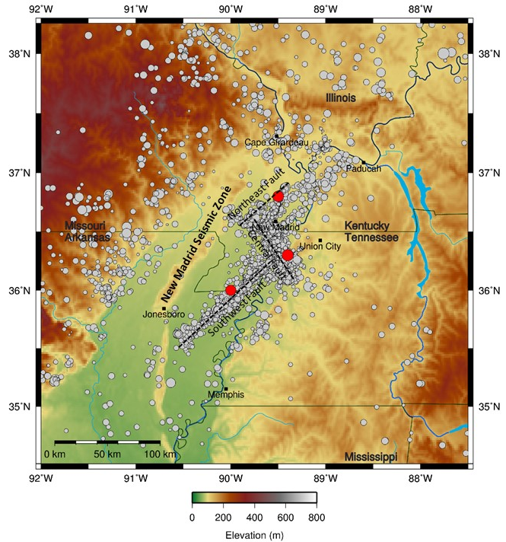
PGDP
December 1811-Febuary 1812
Three large earthquakes (>M 7.0)

Slide 4
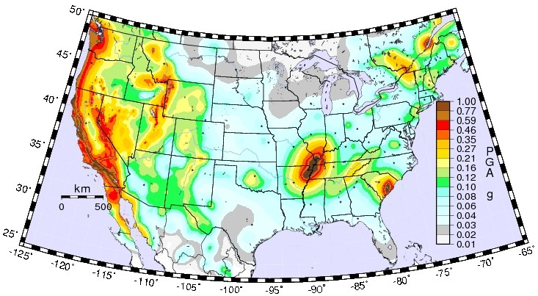
Peak ground acceleration hazard map with a return period of 2,500 years (or 2 percent probability of exceedance in 50 years) for the continental United States (Petersen and others, 2008).

Slide 5
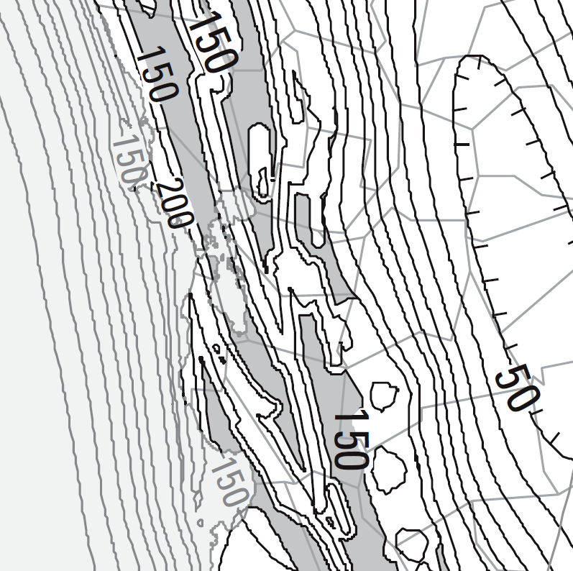
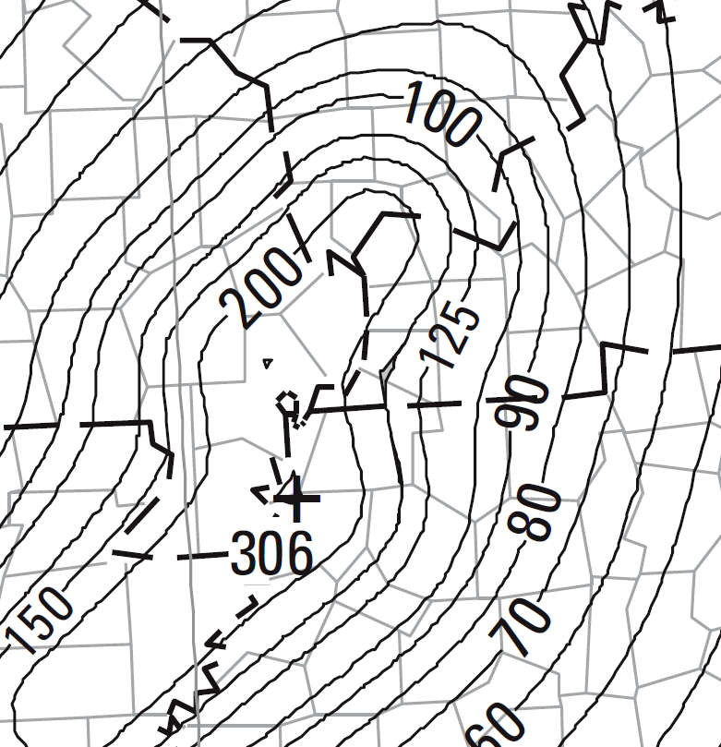
NEHRP-2009 (ASCE_7-10) Design Ground Motion
Paducah
San Francisco
2 g
3 g

Slide 6
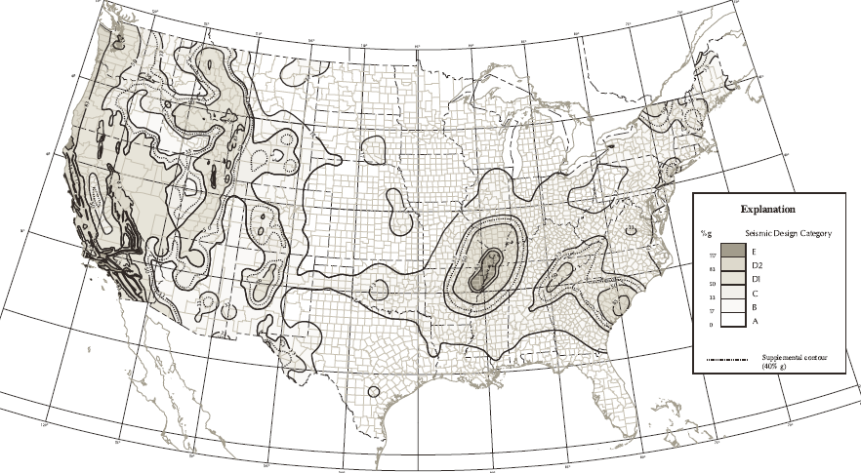
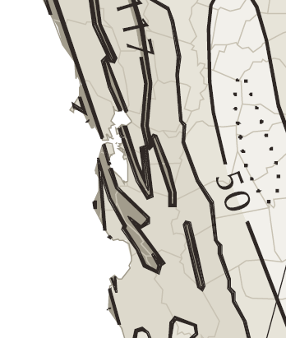
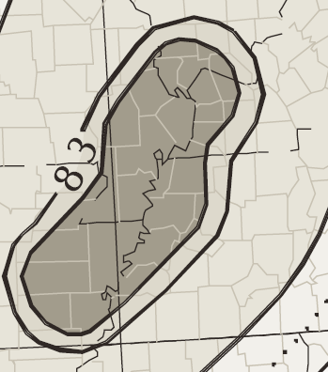
IRC-2000
IRC-2000
Paducah
SFB
San Francisco
Paducah: E (required a professional service)
San Francisco: D2

Slide 7
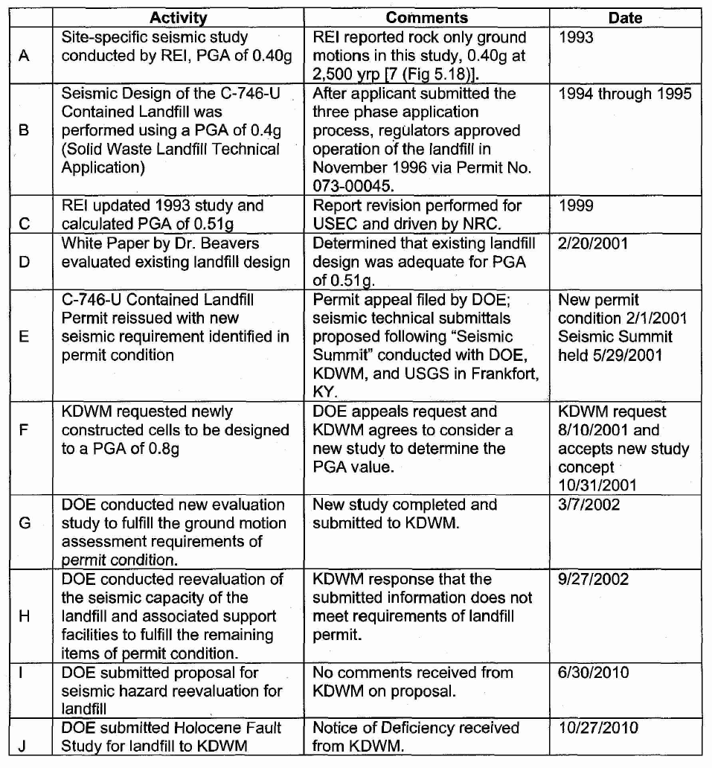
C-746-U Landfill Design Ground Motion
Subtitle D (40 CFR) mandates:
Minimum design ground motion
of 2% PE in 50 years or 2,500
years return period.
USGS-1996 maps (2% in 50yrs)
PGA of 1.2g (B/C)
PGA of 0.8g (hard rock)
There is no landfill in US
that has been designed for
0.7/0.8g PGA.
(Beavers, 2010)

Slide 8
The extreme high design ground motion (0.7/0.8g PGA) became a key issue affecting clean-up efforts at PGDP in 2001-2002
Objectives for Phase I (2003-2006)
  Seismic hazard research and assessment
  Temporary network for monitoring seismicity
  Drilling a deep borehole for the Central U.S. Seismic Observatory (CUSSO)
  Report (Wang and Woolery, 2008)

Slide 9
Key findings from Phase I (2003-2006)
  Large uncertainties inherent in the hazard estimates
  Compounding uncertainties makes the National Seismic Hazard Maps difficult, even impossible to understand
  Using simple statistics, mean, median, or certain percentile, to quantify seismic hazards

Slide 10
C-746-U Landfill Design Ground Motion
Subtitle D (40 CFR) mandates:
Minimum design ground motion
of 2% PE in 50 years or 2,500
years return period.
USGS-1996 maps (2% in 50yrs)
PGA of 1.2g (B/C)
PGA of 0.8g (hard rock)
  One of major results from Phase I:
  Design PGA of 0.33g (2011)
(Beavers, 2010)

Slide 11
The extreme high design ground motion (0.7/0.8g PGA) became a key issue affecting clean-up efforts at PGDP
Objectives for Phase I (2003-2006)
  Seismic hazard research and assessment
  Temporary network for monitoring seismicity
  Drilling a deep borehole for the Central U.S. Seismic Observatory (CUSSO)
  Report (Wang and Woolery, 2008)
Objectives for Phase II (2009-2012)
  Continue monitoring seismicity
  Complete the Central U.S. Seismic Observatory (CUSSO)

Slide 12
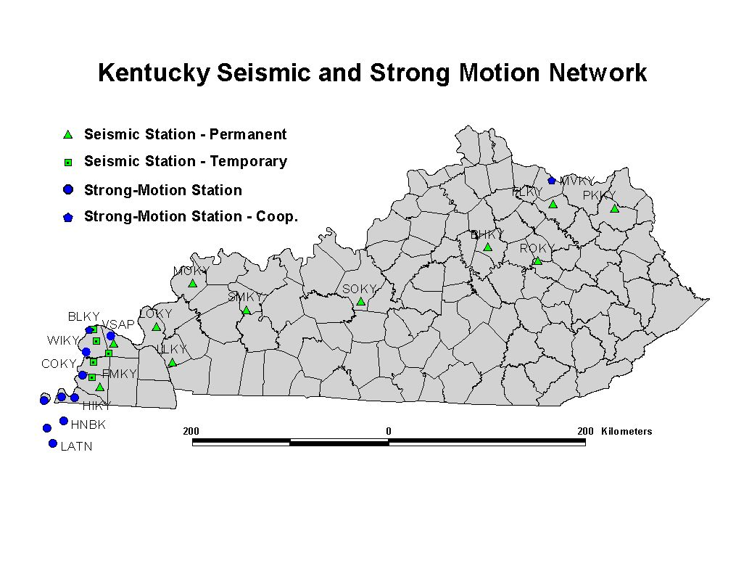
CUSSO

Slide 13
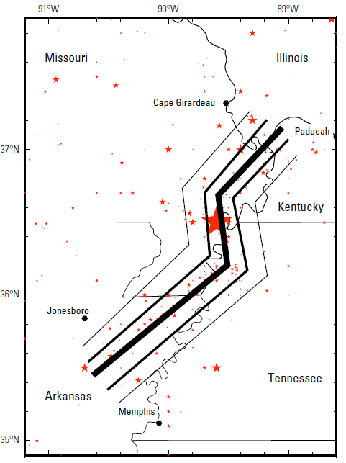
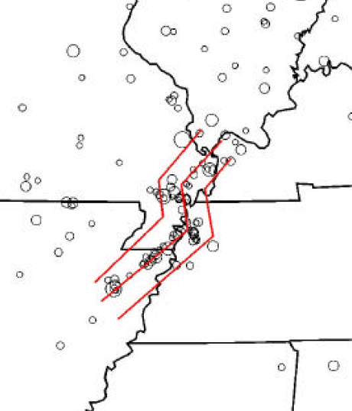
Fictitious faults (red) used to characterize the uncertainty in source location for New Madrid characteristic earthquakes (Frankel et al., 2002)
Locations of the modeled New Madrid hypothetical faults (Petersen et al., 2008)

Slide 14
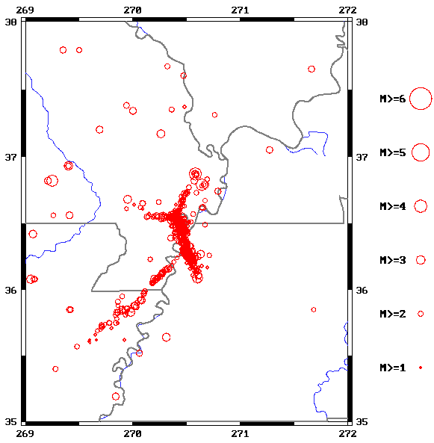
Locations of earthquakes occurring in the New Madrid Seismic Zone between January 2009 and September 2012.
(2)
(1)
Magnitude | Date | Time (UTC) | Latitude | Longitude | Depth (km) | Location
1.9 | 06/29/09 | 04:06:15 | 36.490 | 89.330 | 12.8 | Tyler, Ky.
2.4 | 03/25/11 | 03:12:04 | 37.046 | 88.733 | 6.0 | Massac, Ky.

Slide 15
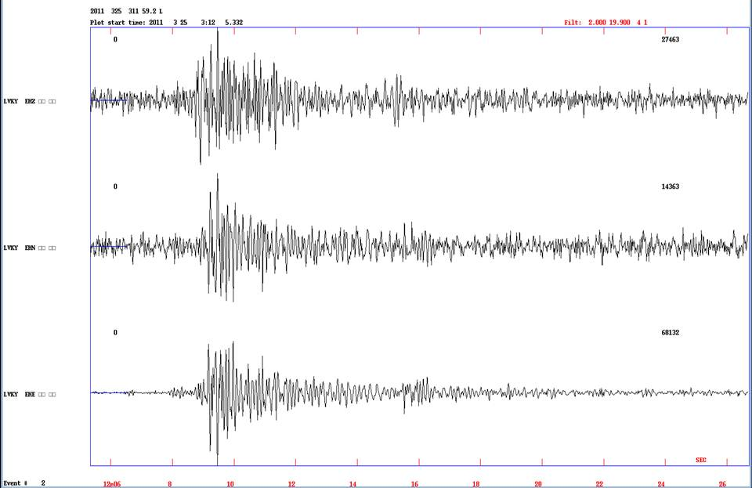
Velocity recordings at station LVKY from the March 25, 2011, earthquake.

Slide 16
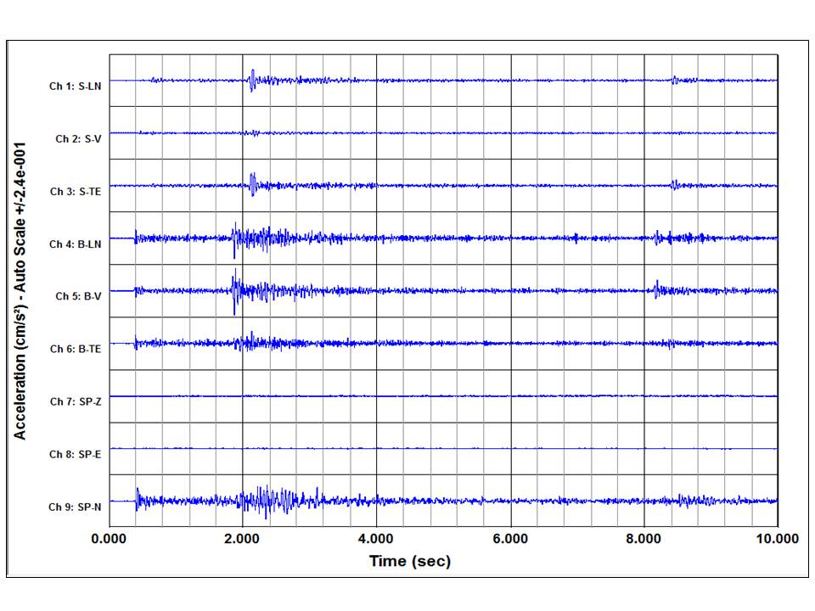
Acceleration recordings of the March 25, 2011, earthquake at station VSAP.

Slide 17
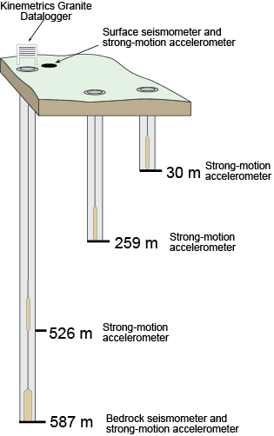
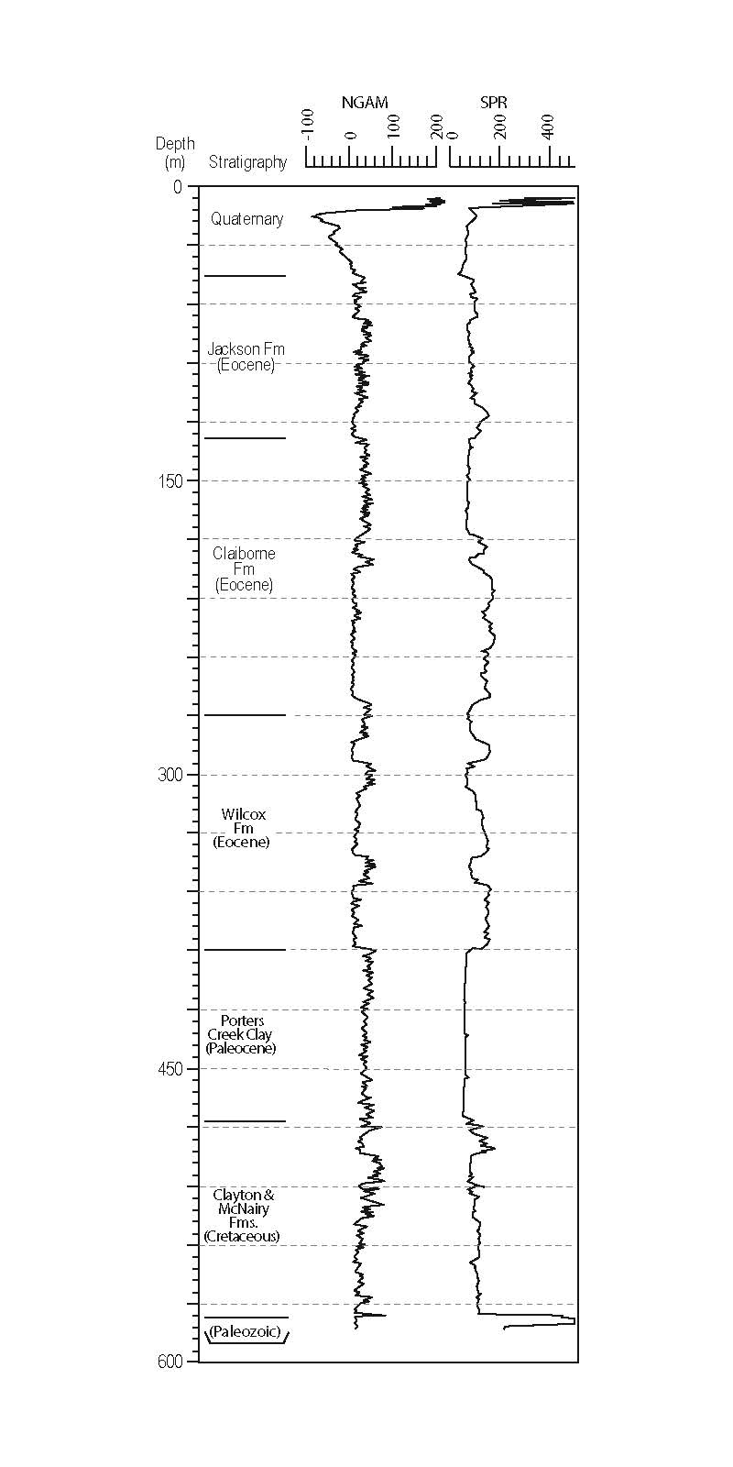
The Central U.S. Seismic Observatory (CUSSO) – Unique in CEUS
Instrumentation
Geologic/geoph. Logs
Shear-wave velocity
CUSSO funding: DOE (UK-KRCEE) - $400K, USGS - $250K, KGS - $200K

Slide 18
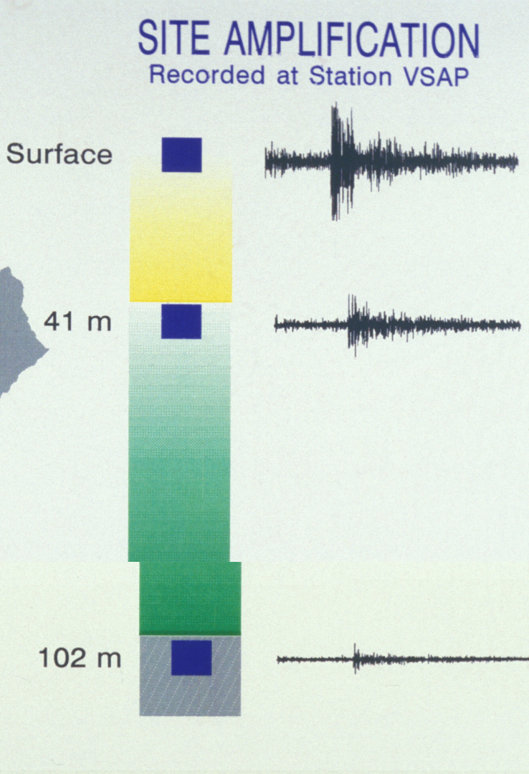
Main purpose of CUSSO: sediment effect on wave propagation,
site effect in particular
Ground motion recordings from M 4.2 earthquake

Slide 19
CUSSO Installation and Operation
- First installation was completed in September 2009
- Operation from September 2009 to July 2010
- Pulled out in August 2010 due to short circuit
- Reinstalled with new cable in December 2010
- Operation from December 2010 to July 2011
- Pulled out in August 2011

Slide 20
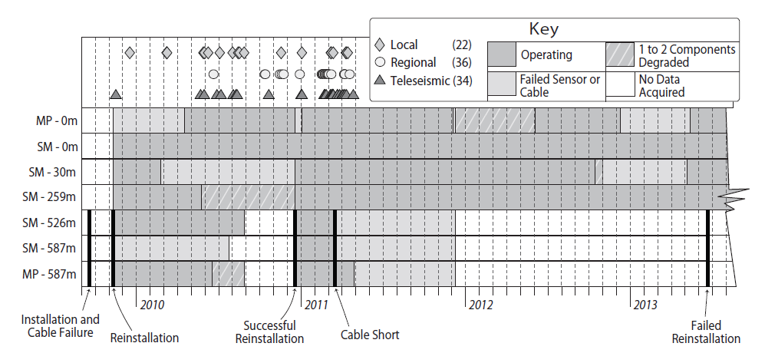
Graphical summary of CUSSO’s history
Total 95 earthquakes recorded: 24 local earthquakes; 37 regional earthquakes; 34 tele- earthquakes.

Slide 21
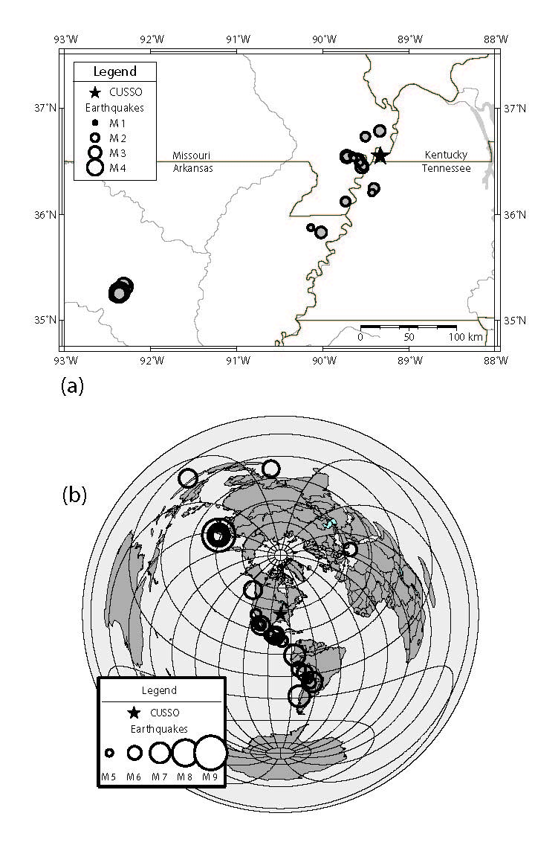
Local and regional earthquakes
Tele- earthquakes

Slide 22
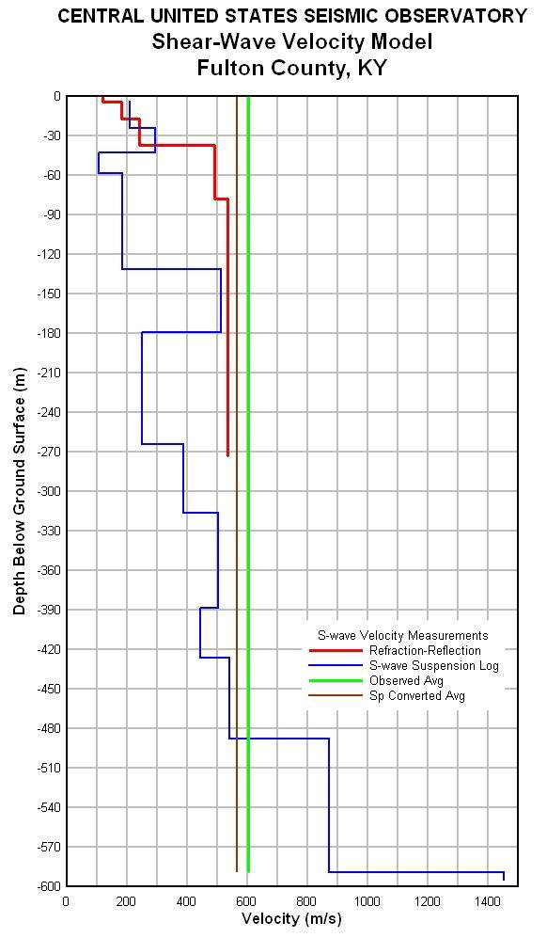
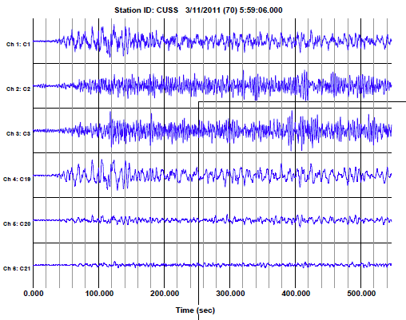
March 11, 2011 Japan earthquake (M9.0)

Slide 23
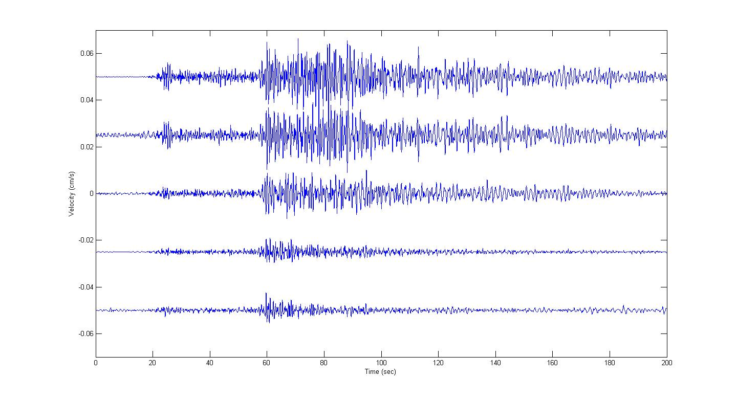
Feb. 28, 2011 AR EQ (M4.7) – Vertical

Slide 24
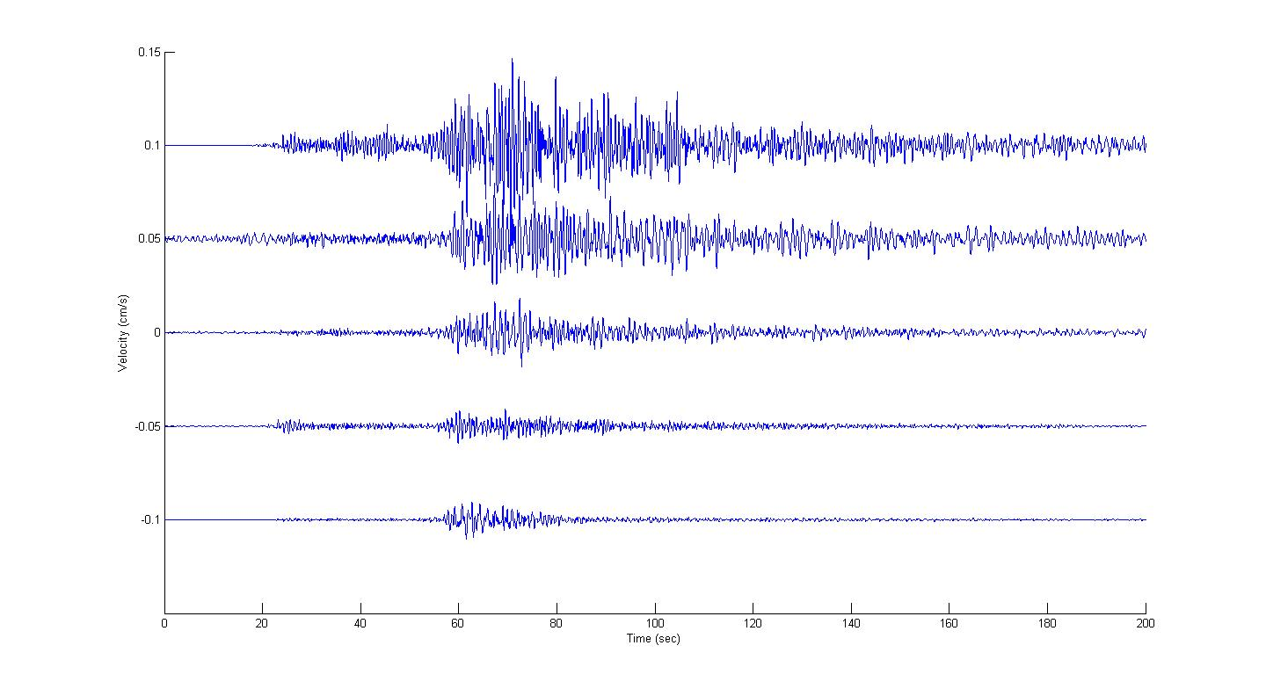
Feb. 28, 2011 AR EQ (M4.7) – Horizontal 1

Slide 25
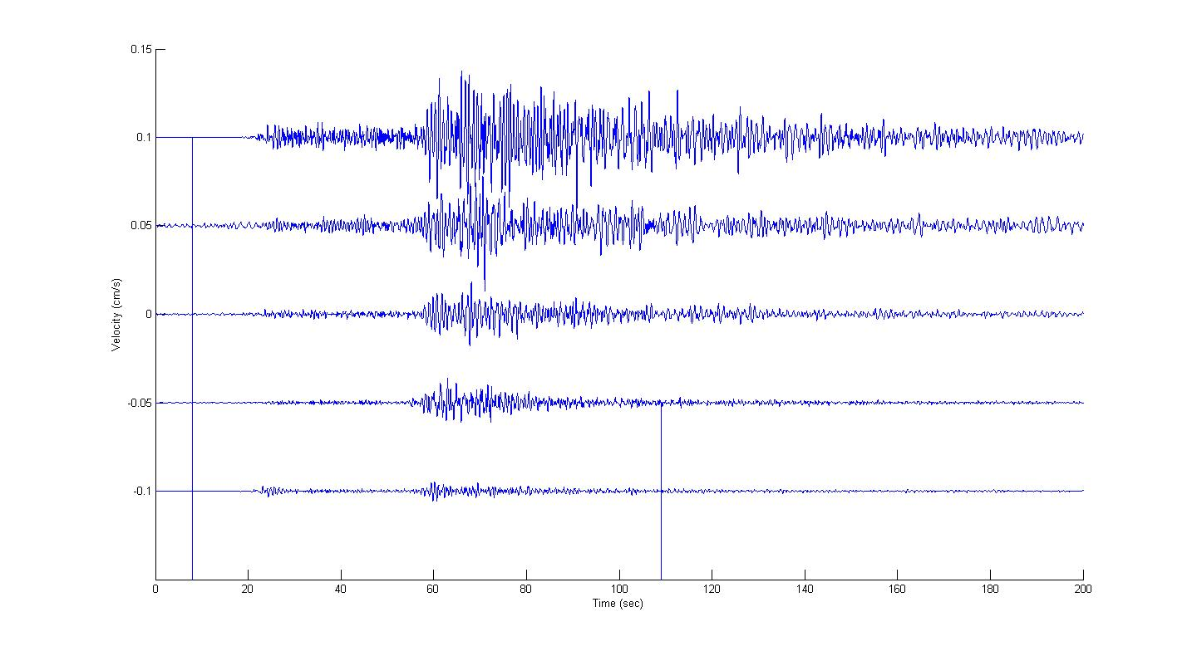
Feb. 28, 2011 AR EQ (M4.7) – Horizontal 2

Slide 26
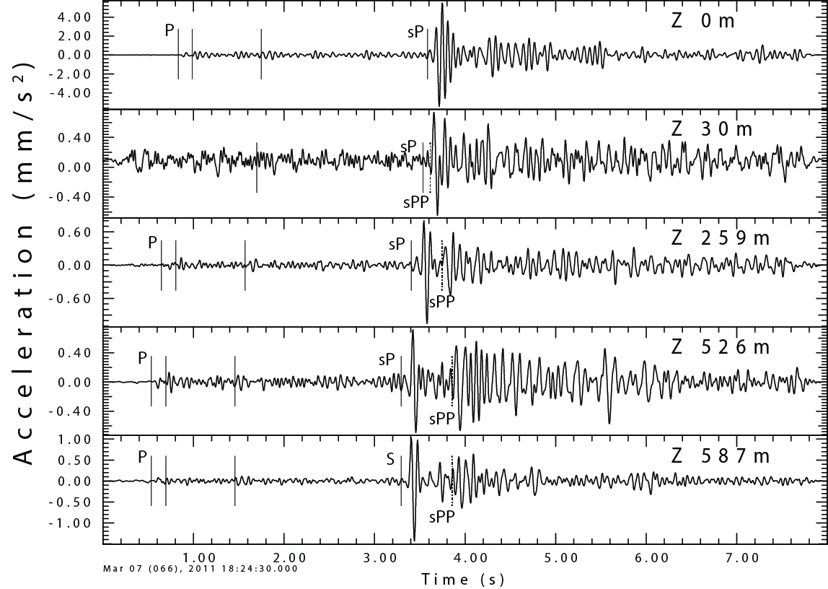
Vertical-component recordings of an M 2.3 earthquake 22 km west of CUSSO.

Slide 27
Summary
The observed seismicity suggests that the active faults of the New Madrid Seismic Zone may not extend into the Jackson Purchase Region
CUSSO provides a test site for verification and calibration of weak and strong motion propagations in thick sediments
Our research has helped resolving the seismic design issue for PGDP, and has positive impact on the region

